Slide 1
Data Visualisation
Theory and practice

Slide 2
Session overview
Introduce some theory / literature on effective data visualisation
Discuss the data visualisations you’ve brought
Introduce the R package ggplot and how it conceptualizes/implements plots.
Present a consolidation exercise (Optional)

Slide 3
By the end of this session you will be able to:
Explain why data visualisations should be designed to tell a story.
Appraise the data-to-ink ratio as a maxim for designing graphs.
Critically evaluate data visualisations from both peer-reviewed papers and media sources.
Describe the three fundamental layers of a ggplot plot: data, aesthetics and geoms.
Modify example code to produce their own data visualisations in ggplot2.

Slide 4
What is a data visualisation?

Slide 5
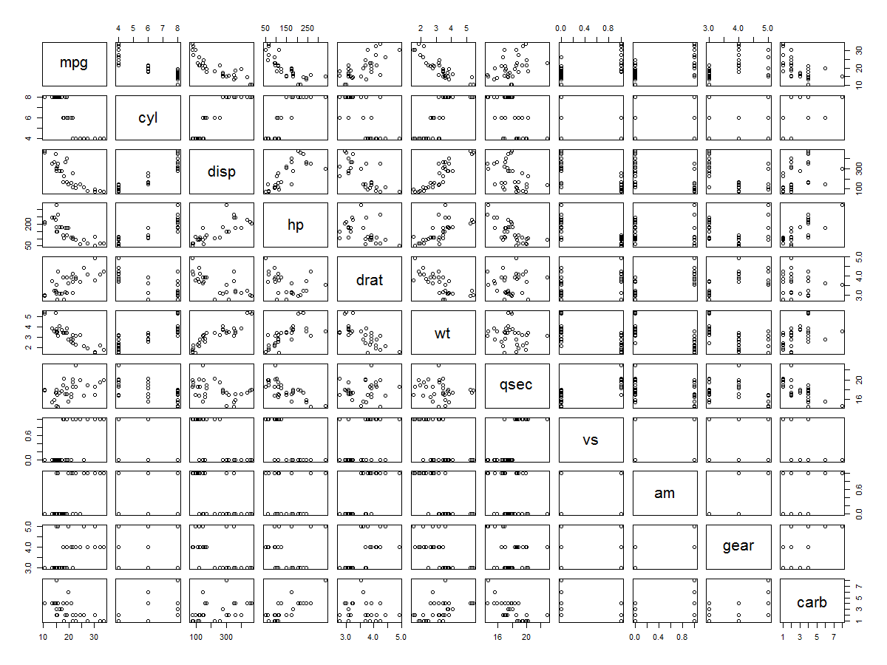

Slide 6
Data visualisations are stories/ arguments.

Slide 7
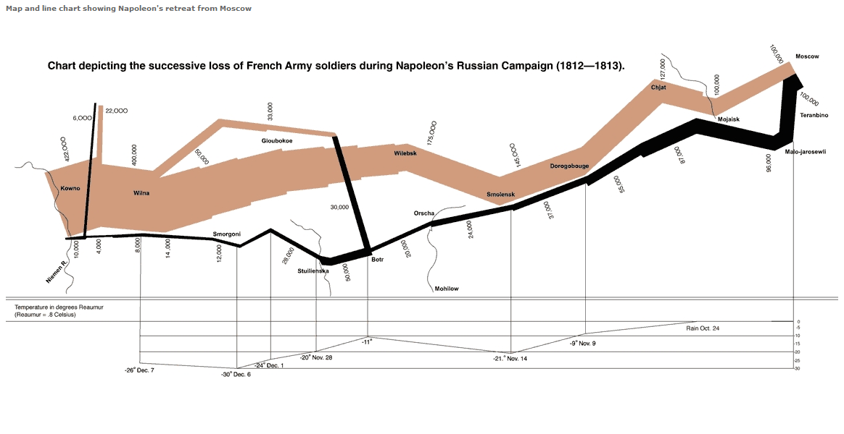

Slide 8
Tell the truth and nothing but the truth (don’t lie, and don’t lie by omission)
https://towardsdatascience.com/the-art-and-science-of-data-visualization-6f9d706d673e

Slide 9
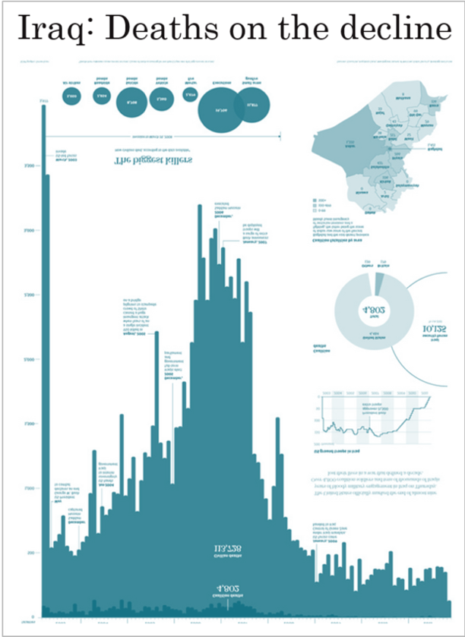
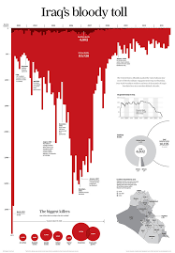

Slide 10
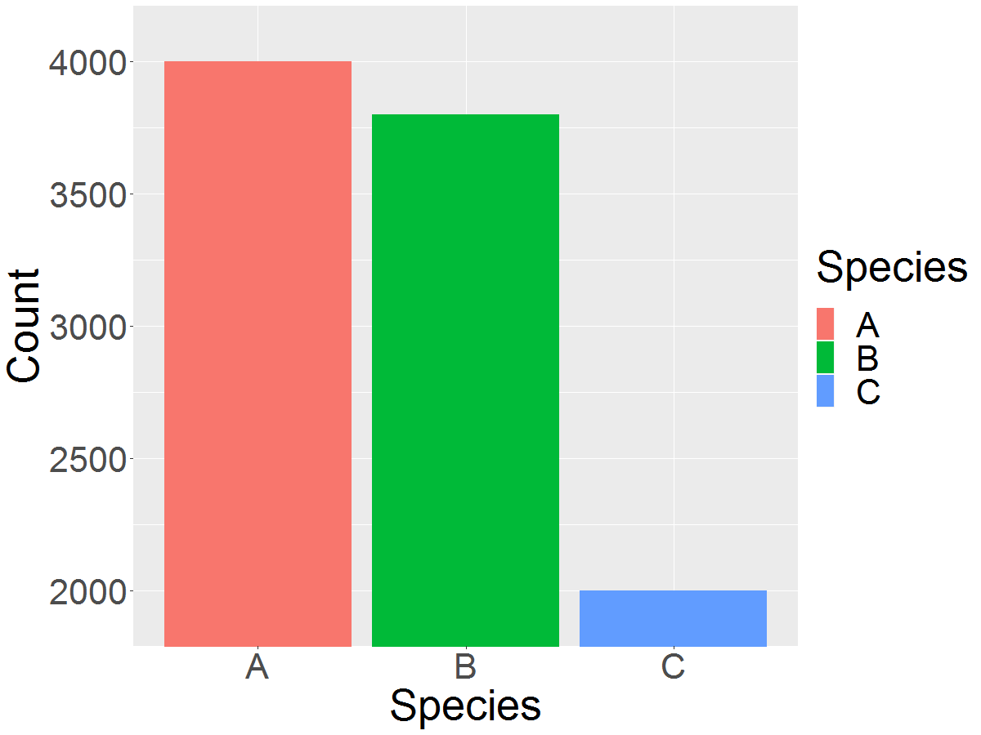
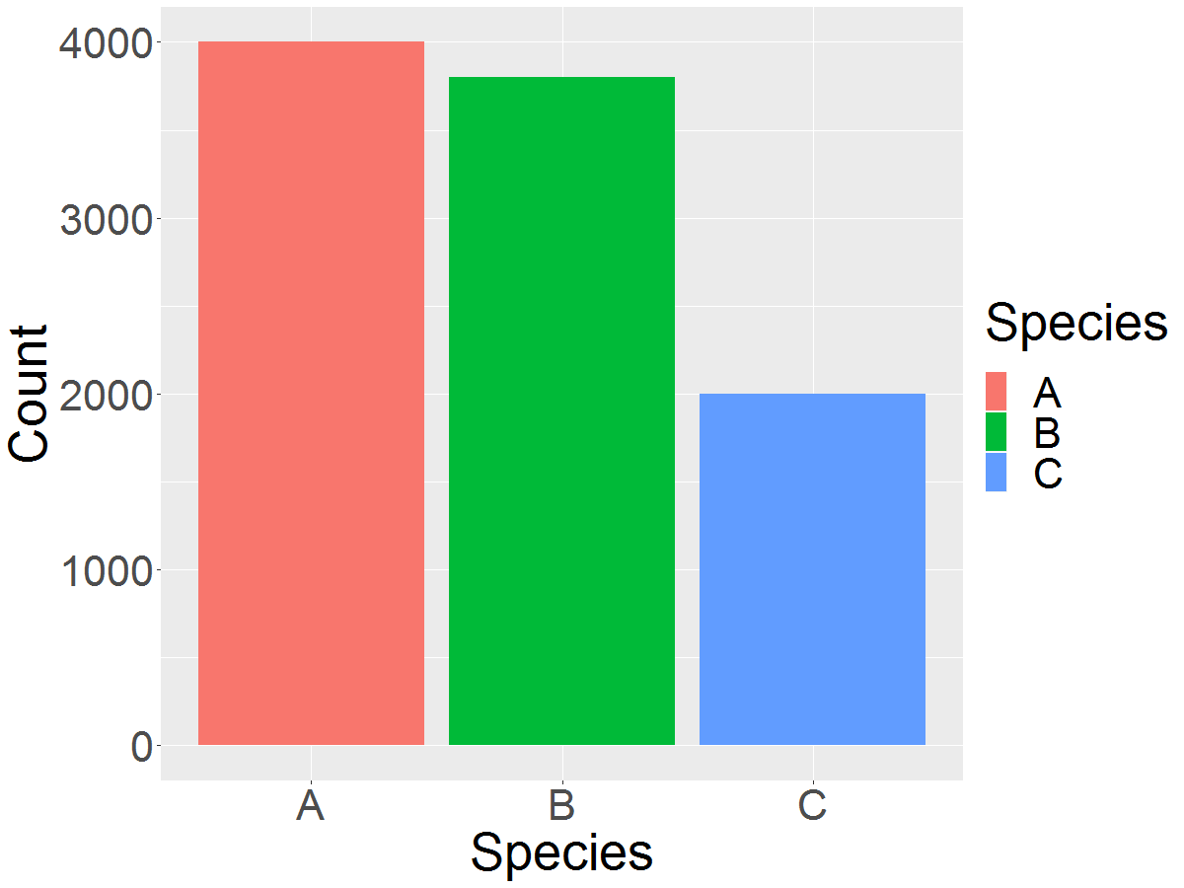

Slide 11
Use encodings that people decode better (where better = faster and/or more accurate)
https://towardsdatascience.com/the-art-and-science-of-data-visualization-6f9d706d673e

Slide 13
Notes:
luminescence and chroma — how light a color is and how vibrant it is — are ordered values, while hue (or shade of color) is unordered

Slide 16
Notes:
Mention Transparency

Slide 17
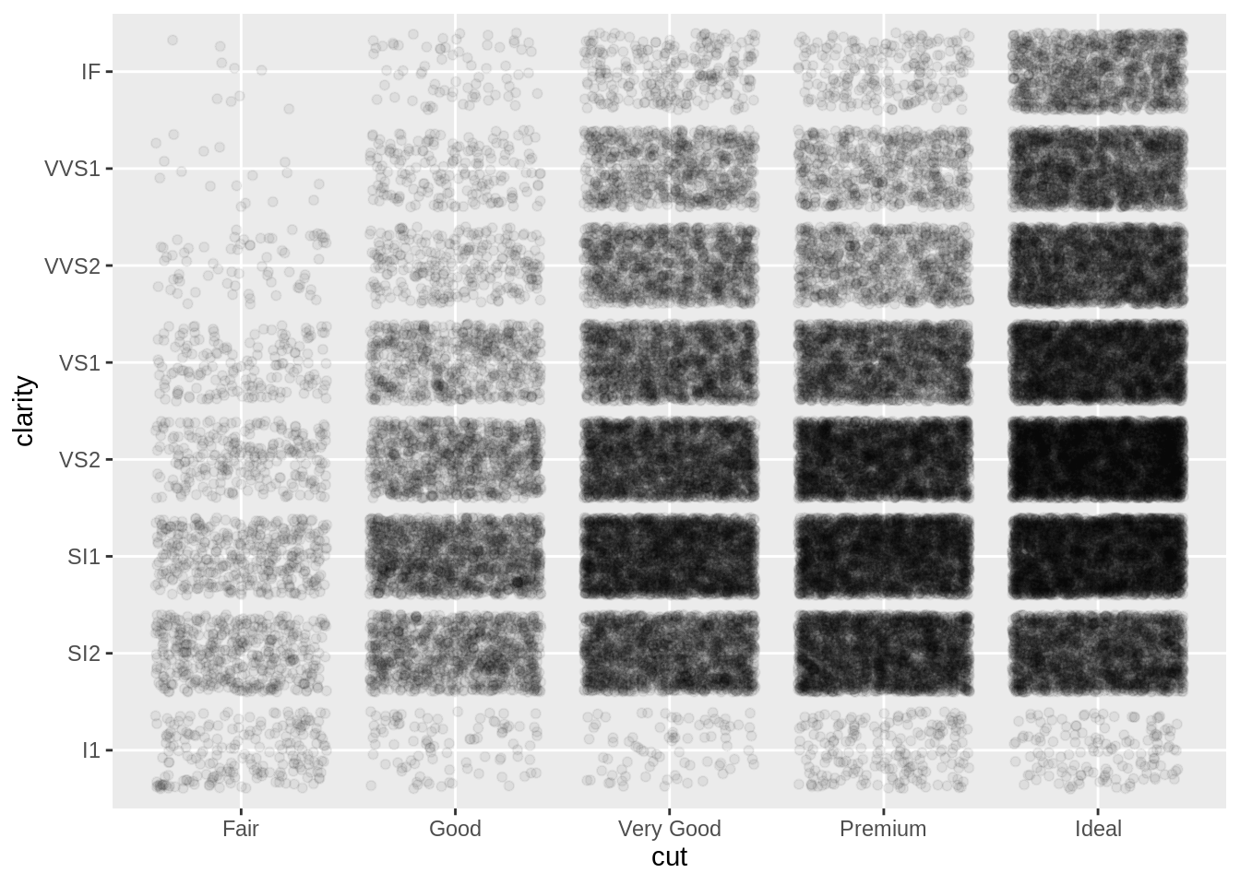
https://towardsdatascience.com/the-art-and-science-of-data-visualization-6f9d706d673e

Slide 18
Why should I care about my data-ink ratio?

Slide 19
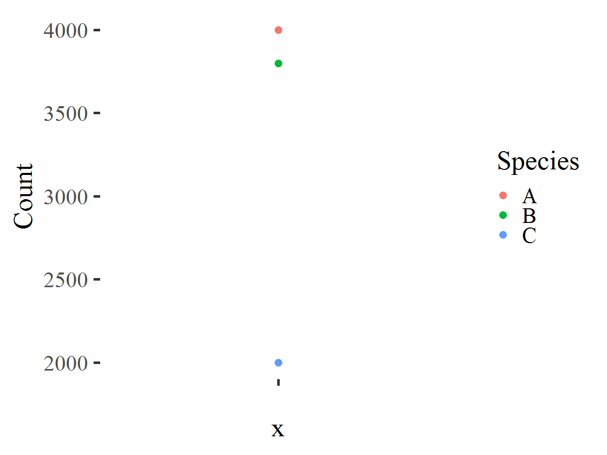

Slide 20
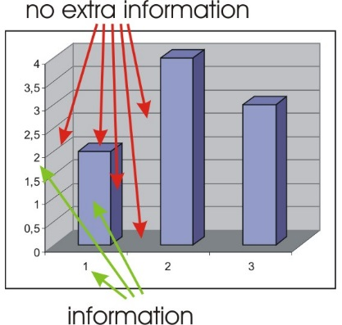

Slide 21
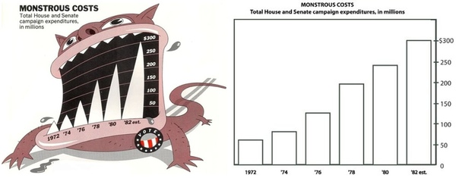

Slide 22
Discuss in pairs

Slide 23
Group Discussion

Slide 24
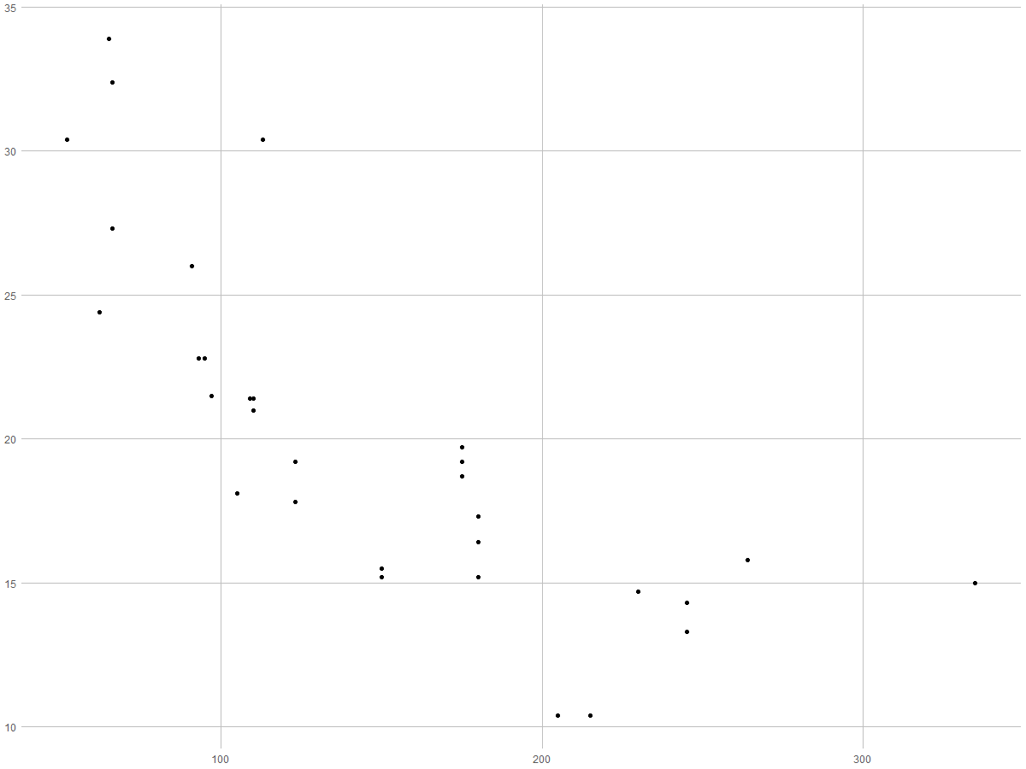
What is ggplot?

Slide 25
It’s hard to succinctly describe how ggplot2 works because it embodies a deep philosophy of visualisation.

Slide 26
What is a grammar for graphics?

Slide 27

Data
MPG Cyl disp
Mazda RX4 21 6 160
Datsun 710 22.8 4 108
Hornet 4 Drive 21.4 6 258
Hornet Sport 18.7 8 360
Valiant 18.1 6 225
Duster 360 14.3 8 360
Merc 240D 24.4 4 146.7
Merc 230 22.8 4 140.8
ggplot(data = mtcars)

Slide 28
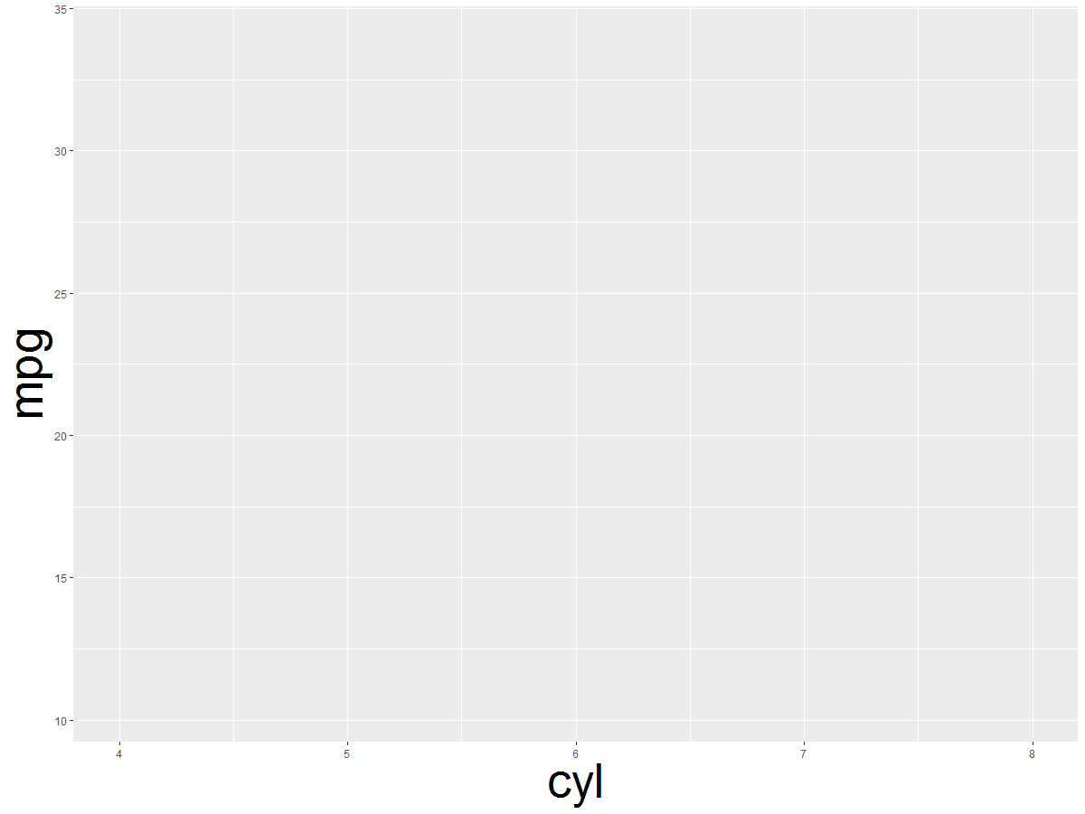

Data
Aesthetics
ggplot(data = mtcars,
aes(x = cyl, y = mpg)
ggplot(data = mtcars,
aes(x = hp, y = mpg)

Slide 29
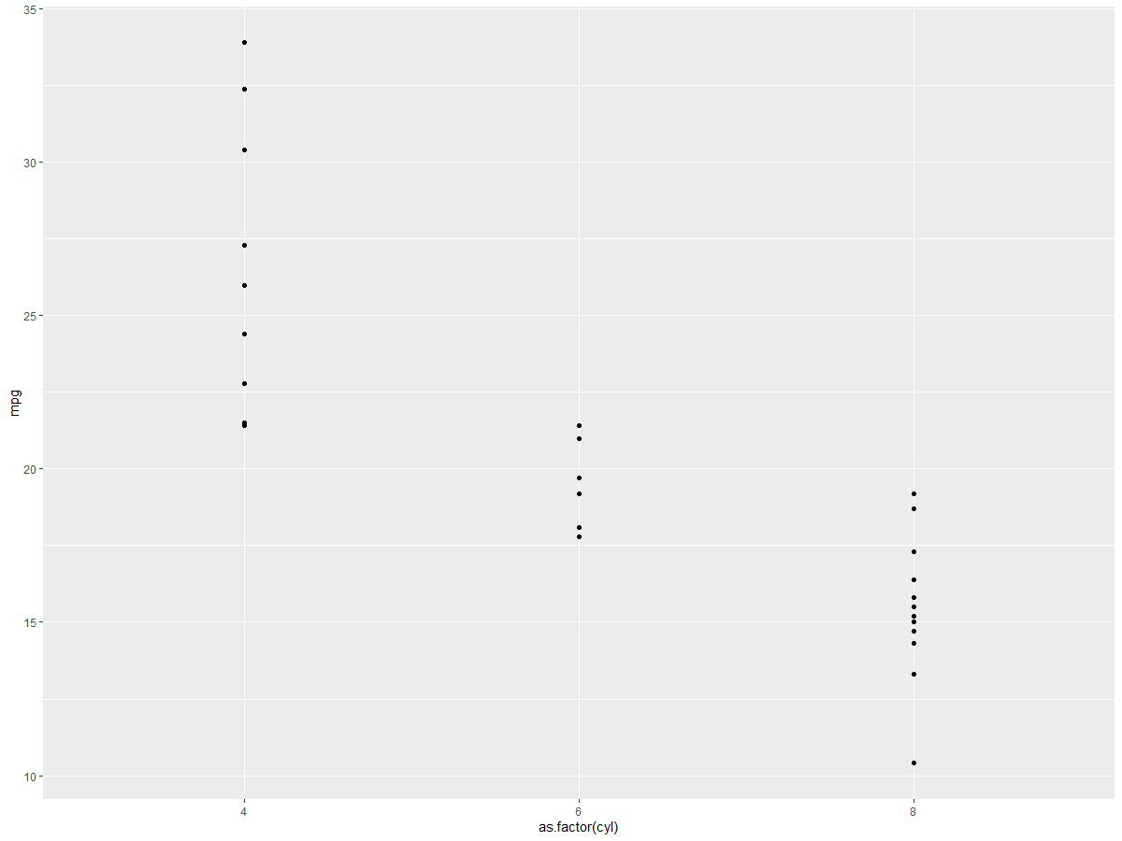
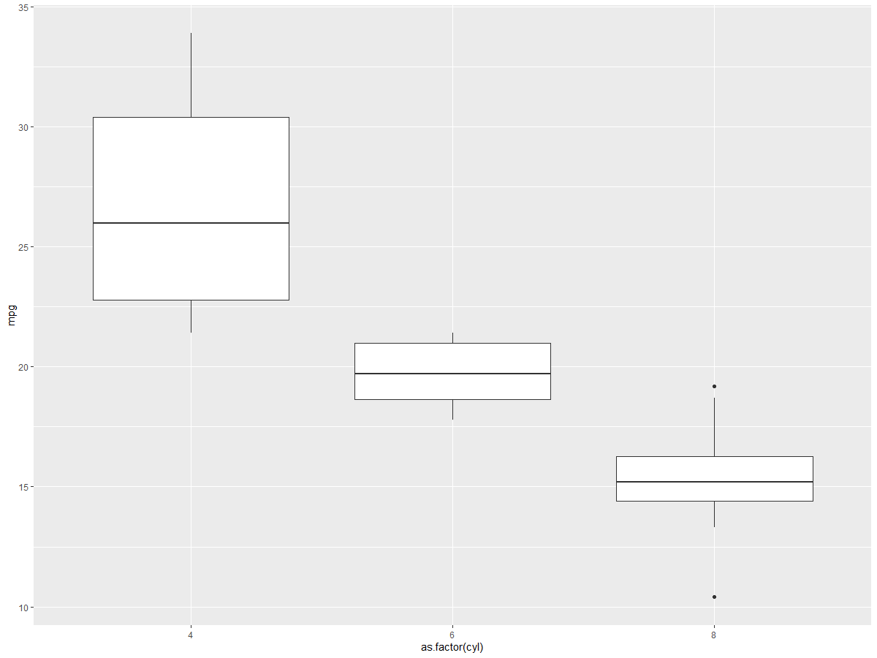
Data, Aesthetics
Geoms
ggplot(data = mtcars, aes(x = as.factor(cyl), y = mpg)) +
geom_point()
ggplot(data = mtcars, aes(x = as.factor(cyl), y = mpg)) +
geom_boxplot()

Slide 30
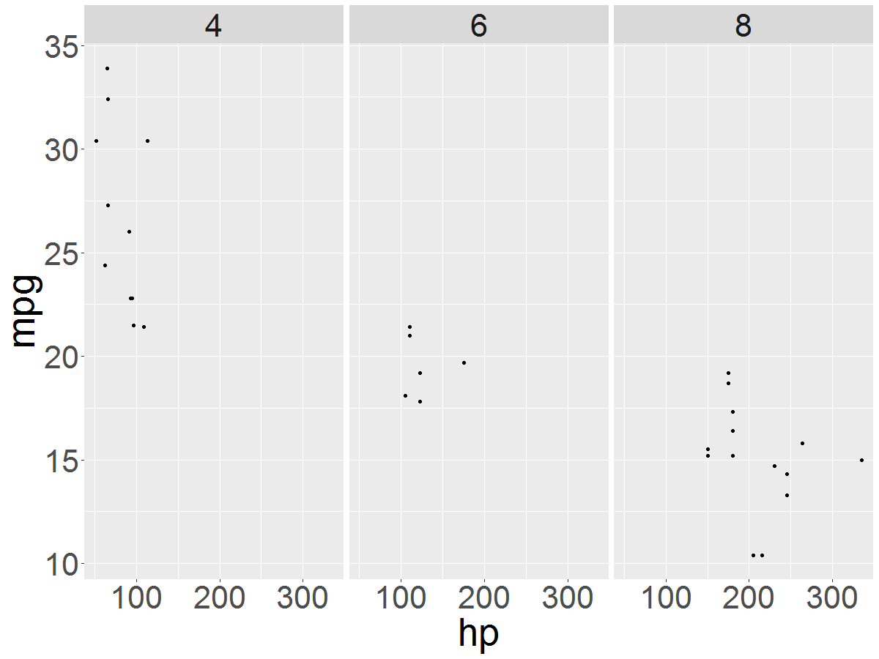
Data, Aesthetics,Geoms
Facets
ggplot(data = mtcars, aes(x = as.factor(cyl), y = mpg)) +
geom_boxplot() +
facet_wrap(~cyl)

Slide 31
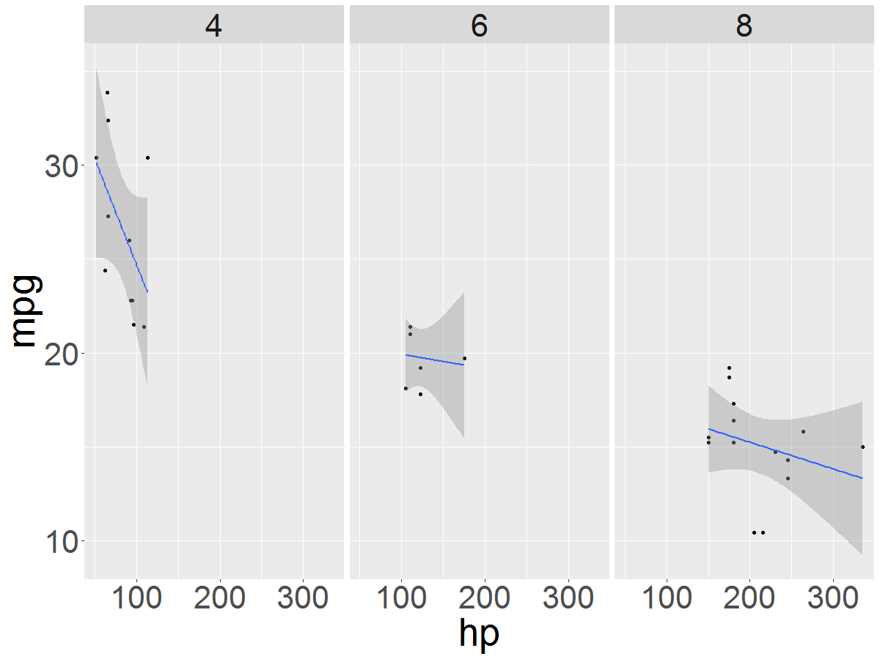
Data, Aesthetics, Geoms, Facets
Statistics
ggplot(data = mtcars, aes(x = as.factor(cyl), y = mpg)) +
geom_boxplot() +
facet_wrap(~cyl)+
geom_smooth(method =“lm”)

Slide 32
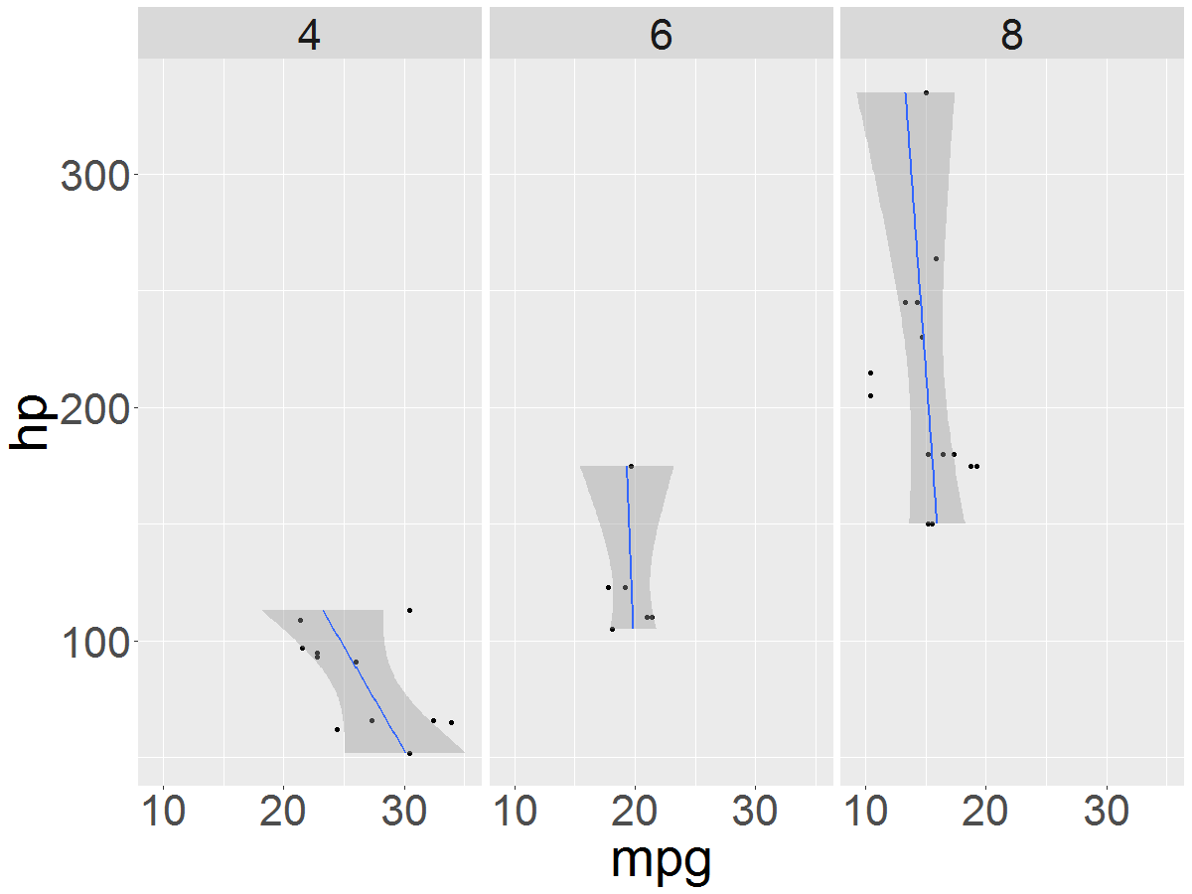
Data, Aesthetics, Geoms, Facets, Statistics
Coordinates
ggplot(data = mtcars, aes(x = hp, y = mpg))+
geom_point()+
facet_wrap(~cyl)+
theme(text = element_text(size = 40))+
geom_smooth(method = "lm")+
coord_flip()

Slide 33
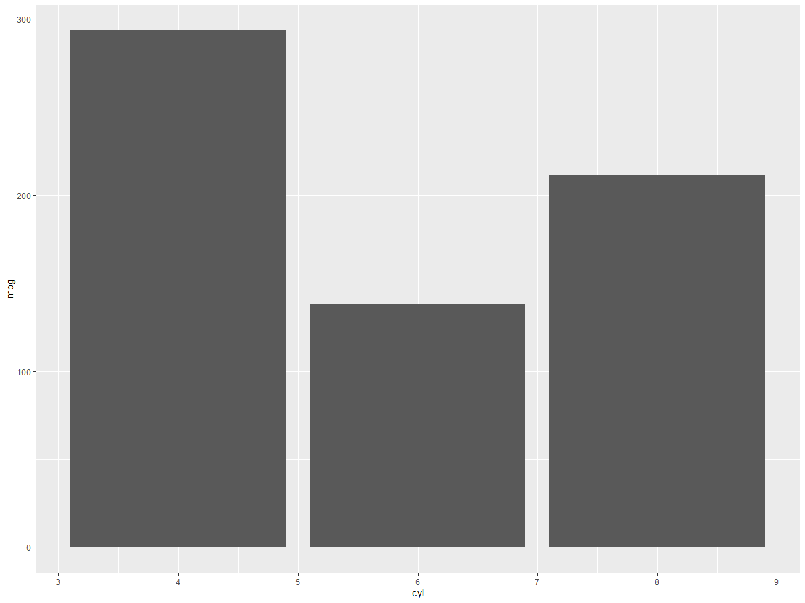
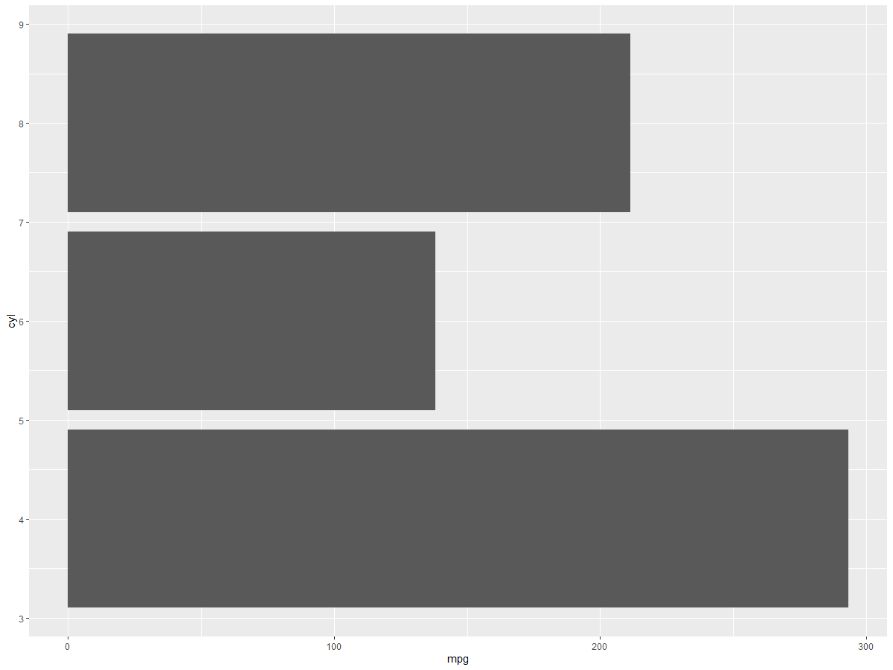
coord_flip()

Slide 34
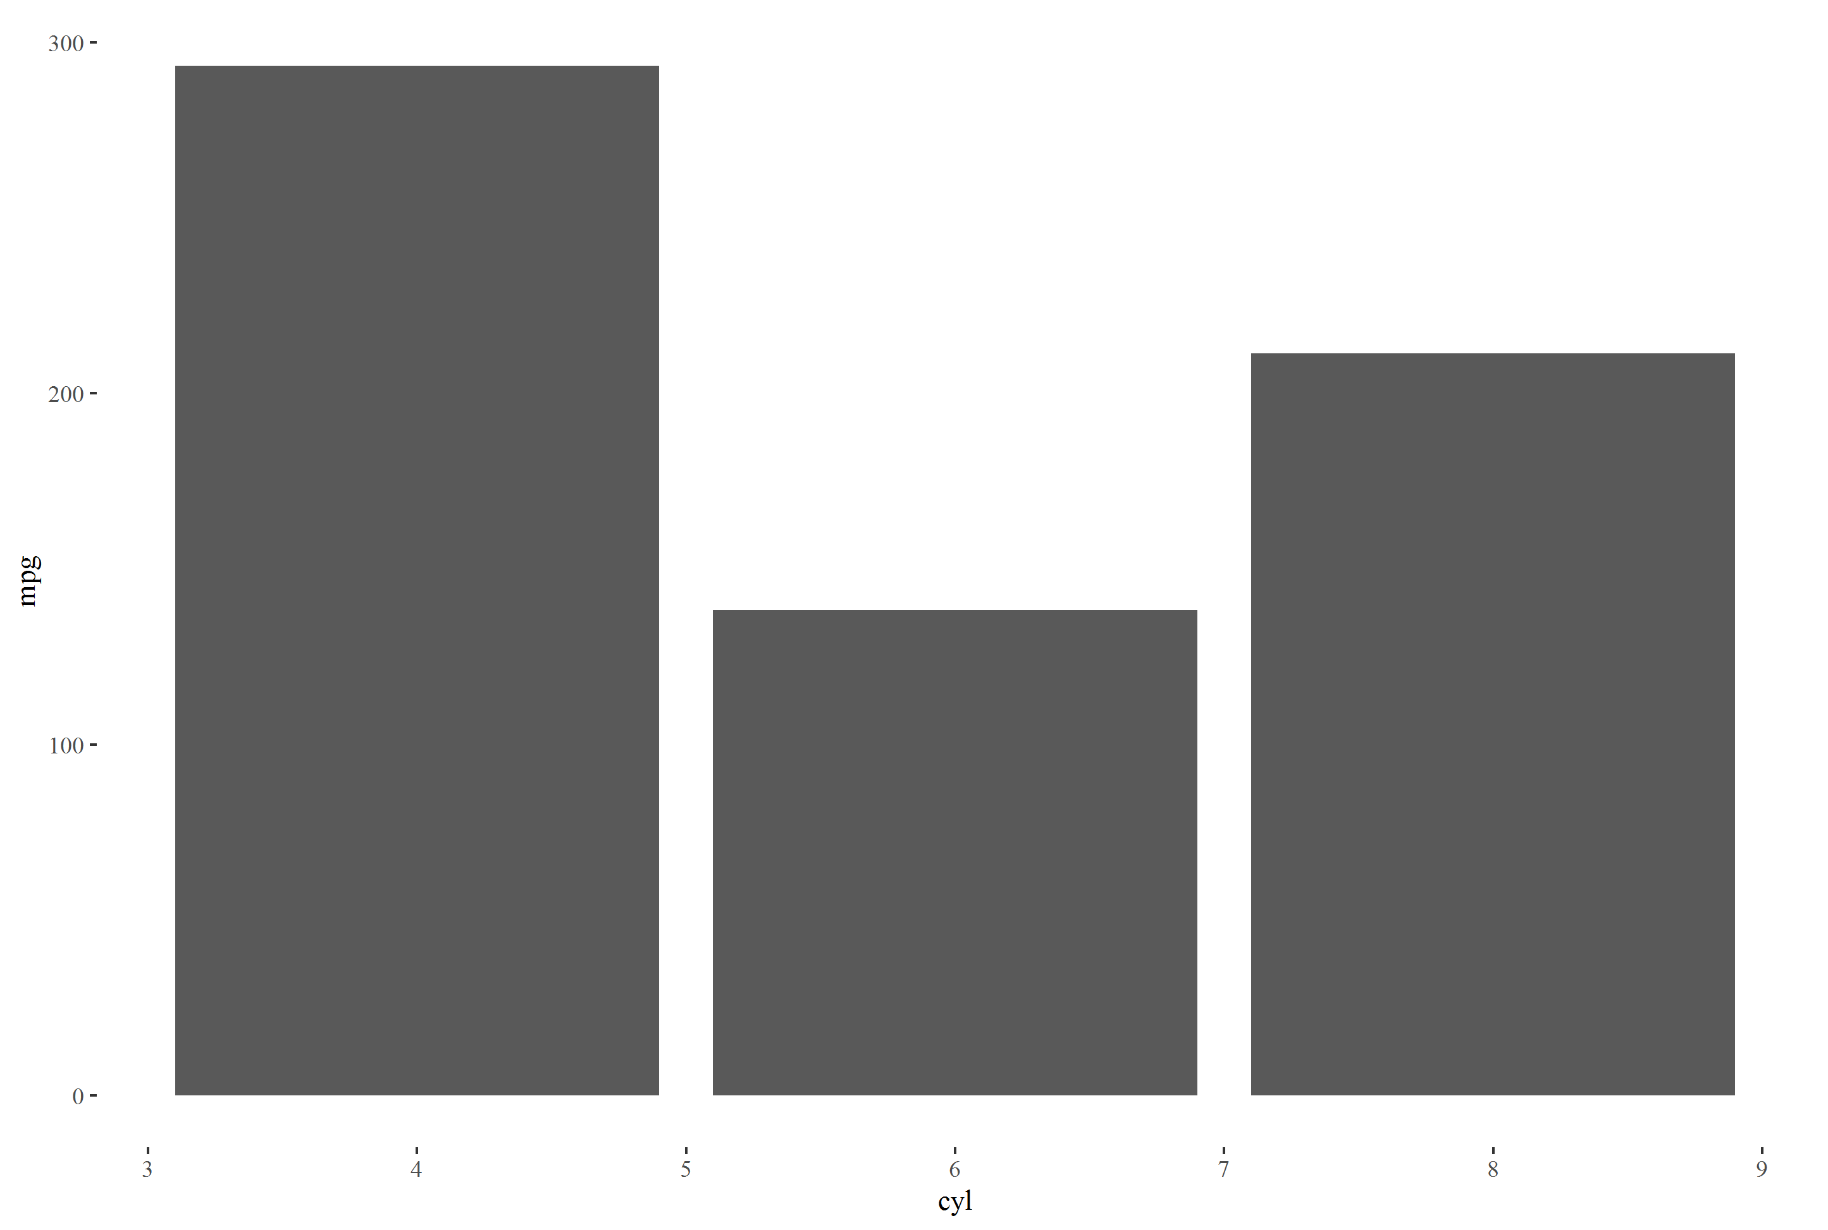
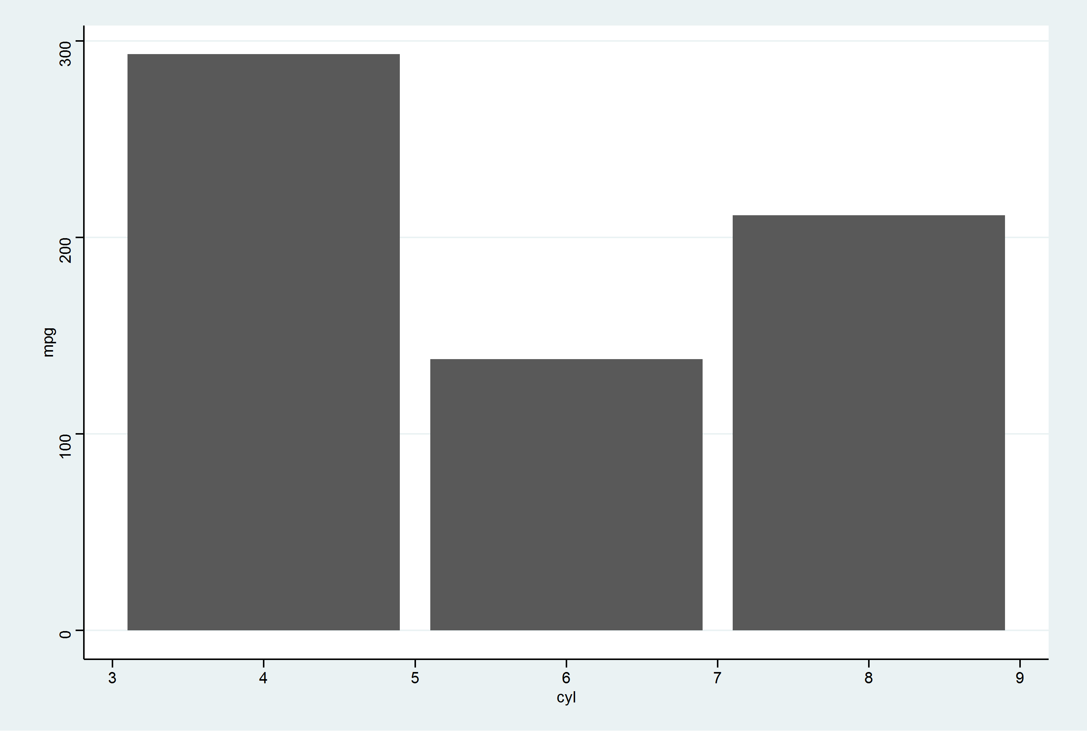
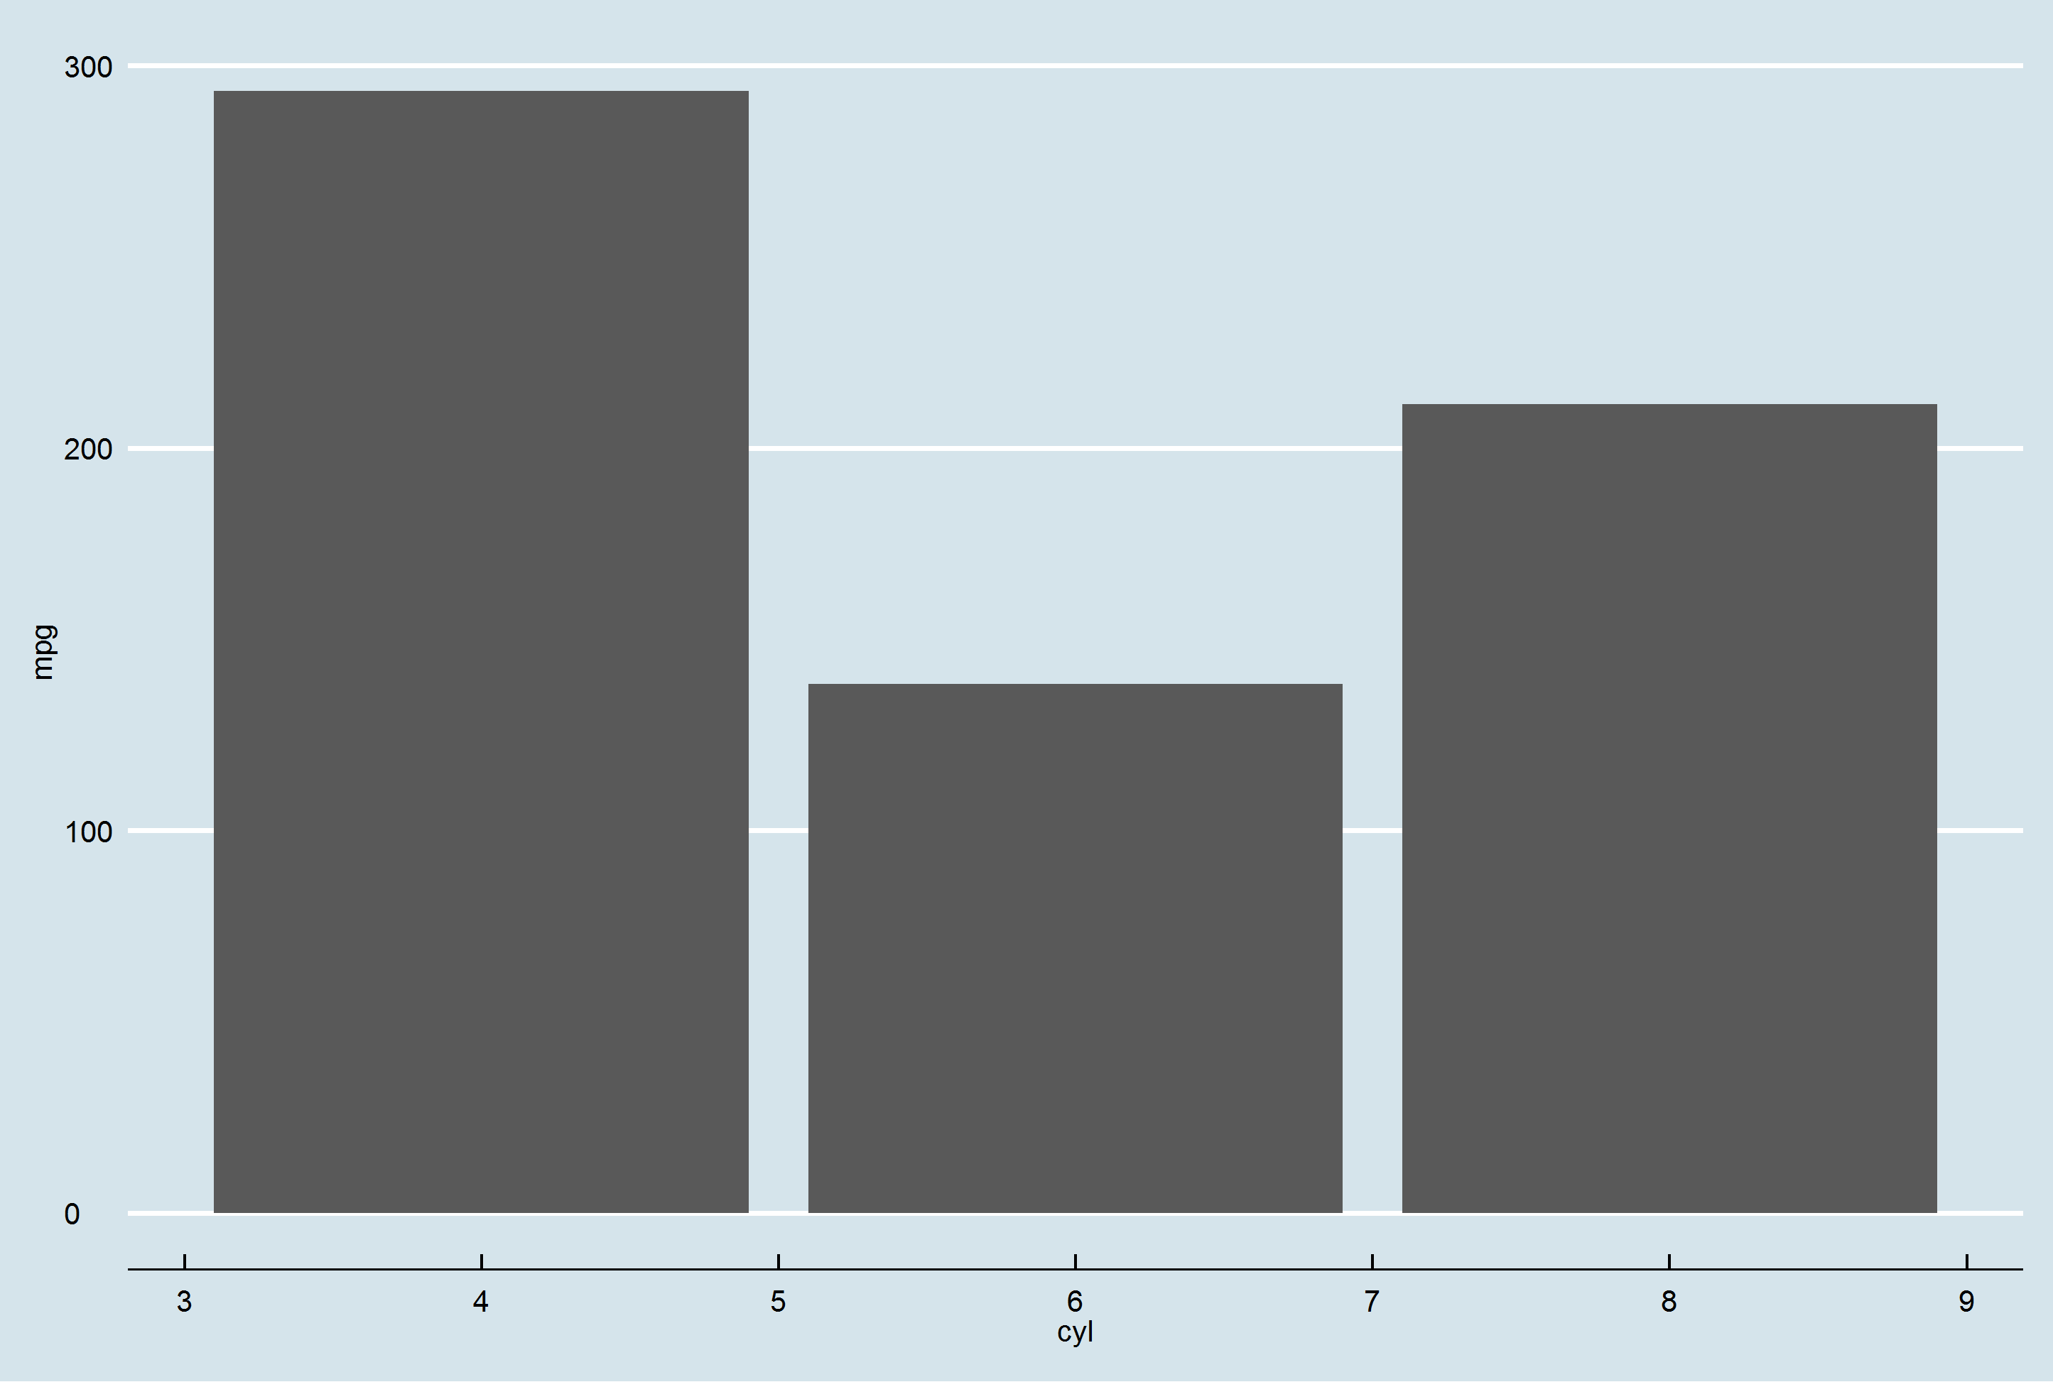
Theme

Slide 35
ggplot(data = mtcars, aes(x = cyl, y = mpg))+
geom_bar(stat="identity")+
theme_stata()
ggplot(data = mtcars, aes(x = cyl, y = mpg))+
geom_bar(stat="identity")+
theme_economist()
ggplot(data = mtcars, aes(x = cyl, y = mpg))+
geom_bar(stat="identity")+
theme_tufte()

Slide 36
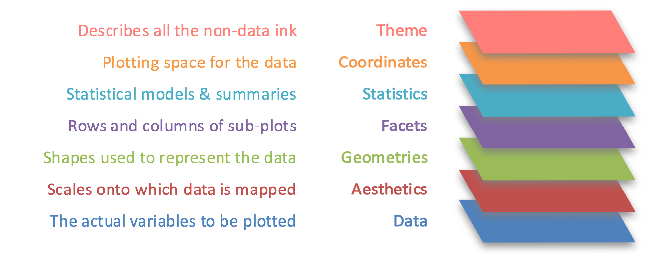

Slide 37
Consolidation Exercise
 | mpg | cyl | disp | hp | drat | wt | qsec | vs | am | gear | carb
Mazda RX4 | 21.0 | 6 | 160.0 | 110 | 3.90 | 2.620 | 16.46 | 0 | 1 | 4 | 4
Mazda RX4 Wag | 21.0 | 6 | 160.0 | 110 | 3.90 | 2.875 | 17.02 | 0 | 1 | 4 | 4
Datsun 710 | 22.8 | 4 | 108.0 | 93 | 3.85 | 2.320 | 18.61 | 1 | 1 | 4 | 1
Hornet 4 Drive | 21.4 | 6 | 258.0 | 110 | 3.08 | 3.215 | 19.44 | 1 | 0 | 3 | 1
Hornet Sportabout | 18.7 | 8 | 360.0 | 175 | 3.15 | 3.440 | 17.02 | 0 | 0 | 3 | 2
Valiant | 18.1 | 6 | 225.0 | 105 | 2.76 | 3.460 | 20.22 | 1 | 0 | 3 | 1
Duster 360 | 14.3 | 8 | 360.0 | 245 | 3.21 | 3.570 | 15.84 | 0 | 0 | 3 | 4
Merc 240D | 24.4 | 4 | 146.7 | 62 | 3.69 | 3.190 | 20.00 | 1 | 0 | 4 | 2
Merc 230 | 22.8 | 4 | 140.8 | 95 | 3.92 | 3.150 | 22.90 | 1 | 0 | 4 | 2
Merc 280 | 19.2 | 6 | 167.6 | 123 | 3.92 | 3.440 | 18.30 | 1 | 0 | 4 | 4
Merc 280C | 17.8 | 6 | 167.6 | 123 | 3.92 | 3.440 | 18.90 | 1 | 0 | 4 | 4
Merc 450SE | 16.4 | 8 | 275.8 | 180 | 3.07 | 4.070 | 17.40 | 0 | 0 | 3 | 3
Merc 450SL | 17.3 | 8 | 275.8 | 180 | 3.07 | 3.730 | 17.60 | 0 | 0 | 3 | 3
Merc 450SLC | 15.2 | 8 | 275.8 | 180 | 3.07 | 3.780 | 18.00 | 0 | 0 | 3 | 3
Cadillac Fleetwood | 10.4 | 8 | 472.0 | 205 | 2.93 | 5.250 | 17.98 | 0 | 0 | 3 | 4
Lincoln Continental | 10.4 | 8 | 460.0 | 215 | 3.00 | 5.424 | 17.82 | 0 | 0 | 3 | 4
Chrysler Imperial | 14.7 | 8 | 440.0 | 230 | 3.23 | 5.345 | 17.42 | 0 | 0 | 3 | 4
Fiat 128 | 32.4 | 4 | 78.7 | 66 | 4.08 | 2.200 | 19.47 | 1 | 1 | 4 | 1
Honda Civic | 30.4 | 4 | 75.7 | 52 | 4.93 | 1.615 | 18.52 | 1 | 1 | 4 | 2
Toyota Corolla | 33.9 | 4 | 71.1 | 65 | 4.22 | 1.835 | 19.90 | 1 | 1 | 4 | 1
Toyota Corona | 21.5 | 4 | 120.1 | 97 | 3.70 | 2.465 | 20.01 | 1 | 0 | 3 | 1
Dodge Challenger | 15.5 | 8 | 318.0 | 150 | 2.76 | 3.520 | 16.87 | 0 | 0 | 3 | 2
AMC Javelin | 15.2 | 8 | 304.0 | 150 | 3.15 | 3.435 | 17.30 | 0 | 0 | 3 | 2
Camaro Z28 | 13.3 | 8 | 350.0 | 245 | 3.73 | 3.840 | 15.41 | 0 | 0 | 3 | 4
Pontiac Firebird | 19.2 | 8 | 400.0 | 175 | 3.08 | 3.845 | 17.05 | 0 | 0 | 3 | 2
Fiat X1-9 | 27.3 | 4 | 79.0 | 66 | 4.08 | 1.935 | 18.90 | 1 | 1 | 4 | 1
Porsche 914-2 | 26.0 | 4 | 120.3 | 91 | 4.43 | 2.140 | 16.70 | 0 | 1 | 5 | 2
Lotus Europa | 30.4 | 4 | 95.1 | 113 | 3.77 | 1.513 | 16.90 | 1 | 1 | 5 | 2
Ford Pantera L | 15.8 | 8 | 351.0 | 264 | 4.22 | 3.170 | 14.50 | 0 | 1 | 5 | 4
Ferrari Dino | 19.7 | 6 | 145.0 | 175 | 3.62 | 2.770 | 15.50 | 0 | 1 | 5 | 6
Maserati Bora | 15.0 | 8 | 301.0 | 335 | 3.54 | 3.570 | 14.60 | 0 | 1 | 5 | 8
Volvo 142E | 21.4 | 4 | 121.0 | 109 | 4.11 | 2.780 | 18.60 | 1 | 1 | 4 | 2
Create your own data story
install.packages(ggplot2)
install.packages(ggthemes)
library(ggplot2)
Data <- mtcars
?mtcars
View(Data)
ggplot(?)

Slide 38
Summary
Explain why designing data visualisations to tell a story about data is an effective strategy for good visualisations.
Appraise the data-to-ink ratio as a maxim for designing graphs.
Critically evaluate data visualisations from both peer-reviewed papers and media sources.
Describe the three fundamental layers of a ggplot plot: data, aesthetics and geoms.
Modify example code to produce their own data visualisations in ggplot2.

Slide 39
Q and A

Slide 40
Saving your plots
dpi = 300
ggsave(“nameyourplot.png”)
ggsave(“nameyourplot.jpg”)
ggsave(filename = “nameyourplot.jpg”,
object = plotimadeearlier,
height = 800, width = 800, units = “mm”)

